Slide 1
Dyslipidemia a silent killer
Prof. Quazi Tarikul Islam
FCPS, FACP, FRCP (Glasg. Edin.)
Professor of Medicine
Popular Medical College

Slide 2
History
After world war II-1948 the first large scale study to determine the atherosclerotic heart disease- Framingham Heart Study, Boston, USA.
5209 cases, age 30-62 yrs, studied for 22 yrs up to 1970.
5135 adult offspring were included of the original parent.

Slide 3
History
 Dr. William Kannel concluded that “Atherosclerosis
is a multi factorial events”.
 In the recent years 100 of clinical trials started and
ended on the basis of the original Framingham Heart
Study.

Slide 4
Cardio vascular risk factors
Fixed:
☹ Age
☹ Male sex
☹ Heredity (+ve F/H)
☹ Deletion Polymorphism in ACE Gene
Potentially changeable with treatment:
 Hypertension
 Diabetes Mellitus
 Hyperlipedemia (Dyslipidemia)
 Obesity
 Cigarette smoking

Slide 5
Introduction
Lipids are no longer a cardiologic curiosity
They are a factor in the management of all patients with known or anticipated vascular disease
Its assessment is now integral to the management not only of those with Coronary disease and those suspected of having coronary disease but also of those jeopardized by hypertension, diabetes or smoking
Even without such risk factors, increasing age and male gender also put a cardiovascular burden of the population

Slide 6
Definition & Classification of Lipoproteins
Definition: Conjugated protein composed of a lipid core
and a lipid / protein coat that carry lipids through blood
streams
Classification (based on density) :
Chylomicrons
Very low-density lipoprotein (VLDL)
Intermediate-density lipoprotein (IDL)
Low-density lipoprotein (LDL)
High-density lipoprotein (HDL)
Notes:
There are five major classes of lipoproteins based on their density. The degree to which lipoproteins cause atherosclerosis depends to some extent on their size, and thus their ability to enter and form deposits within the arterial wall. Thus, smaller VLDL, IDL and LDL are all atherogenic, whereas large VLDL and chylomicrons are not. HDL carries cholesterol away from the arterial wall and is protective.
Chylomicrons are the largest in size, lowest in density and are not associated with atherosclerosis. They are synthesised in the gut after a fatty meal. They transport dietary triglyceride from the gut to the sites of use and storage, and are cleared rapidly from the bloodstream, being undetectable 12 hours after a meal.^{1,2}
VLDL are similar in structure to chylomicrons but are smaller. They are produced in the liver and are the main carriers of endogenous (synthesised in the liver rather then dietary) triglycerides and cholesterol to sites for use or storage. As they are also involved in the synthesis of LDL and HDL, VLDL are implicated in atherosclerosis development.^{1,2}
IDL are formed during the breakdown of VLDL and chylomicrons and are also implicated in atherosclerosis development. They contain less triglyceride and more cholesterol than VLDL, and are involved in the recycling of cholesterol by the liver as well as formation of LDL in the blood.^{1,2}
LDL are generated from IDL in the circulation and are the principal lipoproteins involved in atherosclerosis. Oxidised LDL is the most atherogenic form of LDL. They are the main carriers of cholesterol, accounting for 60–70% of plasma cholesterol. They comprise four main subtypes: LDL I, II, III and IV, of which LDL-III is the most atherogenic subclass.^{1,2}
HDL are the smallest but most abundant of the lipoproteins. They return about 20–30% of cholesterol in the blood to the liver from peripheral tissue for excretion. They do not cause atherosclerosis, but actually protect against its development. There are two main subtypes: HDL2 and HDL3.^{1,2}
References
1. In: Fast Facts - Hyperlipidaemia. Eds Durrington P, Sniderman A. Health Press Ltd, Oxford, 2000. 1-17.
2. In: Manual of Lipid Disorders, 2nd Edition. Eds Gotto A, Pownall H. Williams & Wilkins, US, 1999. 2-10.

Slide 7
Structure of Lipoproteins
Free cholesterol
Phospholipid
Triglyceride
Cholesteryl ester
Apolipoprotein
Notes:
Lipids can be divided into two main groups, simple and complex. The two most important simple lipids are cholesterol and fatty acids. Lipids become complex lipids when fatty acids undergo esterification to produce esters.¹⁻³
Simple lipids Cholesterol is a soft waxy substance present in all cells of the body. Most tissues can produce cholesterol, but it is synthesised primarily in the liver and small intestine. Approximately 50% of the cholesterol requirement is synthesised, whilst the rest is obtained from animal produce in the diet. Cholesterol is important in the repair of cell membranes and in the synthesis of steroid hormones, vitamin D and bile acids. Fatty acids are the simplest form of lipid found in the body and are an important energy source. They exist as saturated, monounsaturated and polyunsaturated forms, distinguished by the number of bonds between the hydrocarbon chain and carbon atoms. The most common fatty acids in the body are stearic and palmitic (saturated), and oleic (monounsaturated). Fatty acids exist freely in the plasma mostly bound to albumin, but are stored in adipose tissue as triglycerides.¹⁻³
Complex lipids Triglycerides are mainly stored in adipose tissue and are the main lipid currency of the body. Phospholipids are glycerol esters containing two fatty acids. They have a water-soluble and a lipid-soluble surface and are an important component of the cell membrane. Cholesterol esters, oleate and linoleate, are the storage molecules of cholesterol in cells.¹⁻³
Lipoproteins In order for these insoluble lipids to be transported around the body in the blood they are incorporated into lipoproteins. These multimolecular packages consist of a hydrophobic core containing cholesteryl esters and triglyceride, surrounded by a hydrophilic surface layer of phospholipids, proteins and some free cholesterol. While structurally similar, lipoproteins vary in their proportions of component molecules and the type of proteins present.¹⁻³
References
1. In: Fast Facts - Hyperlipidaemia. Eds Durrington P, Sniderman A. Health Press Ltd, Oxford, 2000. 1-17.
2. In: Manual of Lipid Disorders, 2nd Edition. Eds Gotto A, Pownall H. Williams & Wilkins, US, 1999. 2-10.
3. In: Statins - The HMG-CoA Reductase Inhibitors in Perspective. Eds Gaw A, Packard CJ, Shepherd J. Martin Dunitz 2000, 1-19.

Slide 8
LDL Cholesterol
Strongly associated with atherosclerosis and CHD events
10% increase results in a 20% increase
in CHD risk
Modified by other risk factors
  low HDL cholesterol
  smoking
  hypertension
  diabetes
Notes:
LDL cholesterol has been shown to be strongly associated with the development of atherosclerosis and the risk of CHD events in patients with established CHD (history of angina pectoris, MI etc.) and in those without CHD. This applies to women as well as men, but in women the general level of CHD risk is lower.¹ A 10% increase in LDL cholesterol is associated with an approximate 20% increase in risk for CHD.¹
The association between LDL cholesterol and the risk of CHD events is considerably modified by other risk factors, such as low HDL cholesterol, smoking, hypertension and diabetes. This modification is apparent especially when total cholesterol and LDL cholesterol are only moderately elevated.¹
Reference
1. Wood D et al, for the Joint European Committee, Second Task Force of European and other Societies. Atherosclerosis 1998;140:199–270.

Slide 9
Triglycerides
Associated with increased risk of CHD events
Link with increased CHD risk is complex
- may be related to low HDL levels and highly
atherogenic forms of LDL cholesterol
May have accompanying dyslipidaemias
Normal triglyceride levels <200mg/dl (2.3mmol/l)
Very high triglycerides (>1000mg/dl, 11.3mmol/l) increased pancreatitis risk
Notes:
Hypertriglyceridaemia has been shown to be associated with increased risk of CHD events. However, the association is not as strong as that of LDL cholesterol, and becomes much weaker when other risk factors are taken into account. The link between triglycerides and increased CHD risk is complex and may be related to low HDL levels and highly atherogenic forms of LDL cholesterol.¹ In fasting plasma, triglycerides are transported in VLDL synthesised in the liver, and after meals are also found in chylomicrons. Catabolism of these triglyceride-rich lipoproteins produces remnant lipoproteins that have atherogenic potential.
Normal triglyceride levels are <200 mg/dl (2.3 mmol/l), borderline high 200–400 mg/dl (2.3–4.5 mmol), high 400–1000 mg/dl (4.5–11.3 mmol/l) and very high >1000 mg/dl (11.3 mmol/l).¹
Patients with elevated triglycerides may have accompanying dyslipidaemias that increase the risk for CHD (e.g. familial combined hyperlipidaemia or diabetic dyslipidaemia). Severe hypertriglyceridaemia (>1000 mg/dl, 11.3 mmol/l), possibly due to chylomicrons and large forms of VLDL, increases the risk of pancreatitis but not CHD, as chylomicrons and VLDL are too large to enter the arterial wall.
Reference
1. National Cholesterol Education Program. Circulation 1994;98(3):1333–445.

Slide 10
HDL Cholesterol
HDL cholesterol has a protective effect for risk of atherosclerosis and CHD
The lower the HDL cholesterol level, the higher the risk for atherosclerosis and CHD
  low level (<35mg/dl, 0.9mmol/l) increases risk
HDL cholesterol tends to be low when triglycerides are high
HDL cholesterol is lowered by smoking, obesity and physical inactivity
Notes:
There is a strong inverse association between plasma HDL cholesterol and the risk of CHD; therefore, HDL cholesterol has a protective effect. This has been shown in both patients with CHD and asymptomatic subjects, in men and women, and is independent of LDL cholesterol and other risk factors. The lower the HDL cholesterol level the higher the risk for CHD; a low level (<35 mg/dl, 0.9 mmol/l) increases risk and a higher level (≥60 mg/dl, 1.6 mmol/l) can be considered a negative risk factor.¹ Concentrations of HDL cholesterol tend to be low when triglycerides are high.
Low concentrations of HDL cholesterol are also associated with an atherogenic lifestyle, as HDL cholesterol is lowered by smoking, obesity and physical inactivity.²
A combination of plasma triglycerides >2 mmol/l (180 mg/dl) and HDL cholesterol
<1 mmol/l (40 mg/dl, 1.0 mmol/L) predicts a high risk of CHD, in particular if the cholesterol to HDL cholesterol ratio is greater than 5.²
References
1. National Cholesterol Education Program. Circulation 1994;98(3):1333–445.
2. Wood D et al, for the Joint European Committee, Second Task Force of European and other Societies. Atherosclerosis 1998;140:199–270.

Slide 11
Apolipoproteins
Main protein content of lipoproteins
Functions include:
  facilitation of lipid transport
  activation of three enzymes in lipid metabolism
  lecithin cholesterol acyltransferase (LCAT), lipoprotein lipase (LPL), hepatic triglyceride lipase (HTGL)
  binding to cell surface receptors
Notes:
Apolipoproteins are the protein constituents of lipoproteins and they have three main functions:¹
1. They facilitate lipid transport by interacting with the phospholipids, thereby helping to stabilise cholesterol esters and triglycerides.
2. They regulate the interaction of these lipids with the enzymes lecithin cholesterol acyltransferase (LCAT), lipoprotein lipase (LPL) and hepatic triglyceride lipase (HTGL).
3. They bind to cell surface receptors.
There are eight broad groups of apolipoproteins that have currently been identified. These are designated apo A to F, apo H and apo J. Apolipoprotein B (apo B48 and apo B100) is associated with high levels of LDL and is an important marker for atherosclerosis.²
References
1. In: Statins - The HMG-CoA Reductase Inhibitors in Perspective. Eds Gaw A, Packard CJ, Shepherd J. Martin Dunitz 2000, 1-19.
2. In: Fast Facts - Hyperlipidaemia. Eds Durrington P, Sniderman A. Health Press Ltd, Oxford, 2000. 1-17.

Slide 12
Apolipoproteins, their associated lipoprotein class
and their functions
Apolipoprotein (sub class) | Lipoprotein class | Functions
A (A_{I} , A_{II} & A_{IV}) | HDL | LCAT activation, Scavenger
B (B₄₈ & B₁₀₀) | Chylomicron, VLDL, LDL & IDL | Cholesterol carrier to tissues
C (C_{I} , C_{II} & C_{III}) | HDL & VLDL | Lipoprotein lipase activator
D | HDL | Not clearly defined
E | Chylomicron, VLDL, LDL, IDL & HDL | Cholesterol transport

Slide 13
Exogenous Pathway of Lipid Metabolism
Intestine
Dietary triglycerides
and cholesterol
Chylomicron
LP lipase
Liver
TGs
LP lipase
TGs
Remnant
receptor
Skeletal muscle
Chylomicron
remnant
Adipose
tissue
Notes:
The exogenous metabolic pathway is concerned with the transport and utilisation of dietary fats. Dietary fat is broken down in the gastrointestinal tract into cholesterol, fatty acids and mono- and diglycerides. These molecules, together with bile acids, form water-soluble micelles that carry the lipid to absorptive sites in the duodenum.¹
Normally, virtually all triglyceride (TG) is absorbed, compared with only 50% of cholesterol. Following absorption in the duodenum, chylomicrons are formed which enter the bloodstream to be transported to the liver. On entering the plasma, rapid changes take place in the chylomicron. It is hydrolysed by the enzyme lipoprotein (LP) lipase releasing the triglyceride core, free fatty acids and mono- and diglycerides for energy production or storage. The residual chylomicron undergoes further delipidation, resulting in the formation of chylomicron remnants. These are taken up by the liver, undergo lysomal degradation, and are either used for cell membrane synthesis or excreted as bile salts.¹
Reference
1. In: Fast Facts - Hyperlipidaemia. Eds Durrington P, Sniderman A. Health Press Ltd, Oxford, 2000. 1-17.

Slide 14
Endogenous Pathway of Lipid Metabolism
LPL
Lipoprotein lipase
Modification
Macrophage
LDL
Adipose
tissue
IDL
LPL
LDL
receptor
LPL
Small
VLDL
Hepatic lipase
Large
VLDL
Hepatic lipase
Liver
Notes:
Whilst chylomicrons transport triglyceride from the gut to the liver, VLDL is the analogous particle that transports triglycerides from the liver to the rest of the body. Triglycerides together with cholesterol, cholesterol ester and other lipoprotein particles are transported in VLDL in the bloodstream, where VLDL undergoes delipidation with the enzyme lipoprotein lipase in a similar way to chylomicrons; this is the endogenous pathway of lipid metabolism. During this process, triglyceride is removed from the core and exchanged for cholesterol esters, principally from HDL. Whilst most VLDL is transformed into LDL, the larger VLDL particles are lipolysed to IDL, which is then removed from the plasma directly. Lipoprotein lipase is the main enzyme used in the lipolysis of large VLDL particles, whereas hepatic lipase reacts with the small VLDL and IDL particles.¹
The product of this metabolic cascade, LDL, exists in the plasma in the form of a number of subfractions; LDL I-IV. It has been shown that small dense LDL particles are the most atherogenic. They are absorbed by macrophages within the arterial wall to form lipid-rich foam cells, the initial stage in the pathogenesis of atherosclerotic plaques.¹
The enterohepatic circulation provides a route for the excretion of cholesterol and bile acids.¹
Reference
1. In: Fast Facts - Hyperlipidaemia. Eds Durrington P, Sniderman A. Health Press Ltd, Oxford, 2000. 1-17.

Slide 15
Reverse Cholesterol Transport
Cell
membrane
Liver
LDL
receptor
CE
CE
FC
LCAT
CETP
VLDL, IDL, LDL
HDL
HDL
TG
Peripheral
tissues
Free cholesterol (FC)
TG
Triglycerides
CE
Cholesterol esters
LCAT
Lecithin cholesterol acyl transferase
CETP
Cholesteryl ester transfer protein
Notes:
As cholesterol cannot be broken down within the body, it is eliminated intact. It is transported via HDL from the peripheral tissues to be excreted by the liver. HDL begins as a lipid-deficient precursor which transforms into lipid-rich lipoprotein. In this form it transfers cholesterol either directly to the liver or to other circulating lipoproteins to be transported to the liver for elimination.¹
The observation that HDL acts as a vehicle for the transport of cholesterol for elimination has led to the identification of HDL as a protective factor against the development of atherosclerosis.¹
Reference
1. In: Fast Facts - Hyperlipidaemia. Eds Durrington P, Sniderman A. Health Press Ltd, Oxford, 2000. 1-17.

Slide 16
Dyslipedemia the extreme

Slide 17
Dyslipedemia
→ Elevated level of serum lipids (Cholesterol & TG) are extremely common and are one of the most important risk factor that can be changed.
→ Reduction of LDL level reduces mortality 30% and major coronary events 35%.

Slide 18
Dyslipedemia
→ In a randomized trial it is observed that 40mg
simvastatin for 5 years reduces 25% mortality.
→ AHA declares 100 million American adult have
cholesterol 200 mg/DL and above 52 million have
cholesterol 240 mg/DL.

Slide 19
Factors influence S. cholesterol level
 Hereditary-major role
 Increased dietary fat & unsaturated fatty acid  cholesterol
 Poly-unsaturated fatty acids of plant origin  LDL by  its catabolism
 Dietary fibers  cholesterol by  absorption &  excretion
 Sucrose & Fructose  S. lipids specially TG
 Moderate alcohol consumption elevate HDL by  synthesis of apo-A-I &
changes in activity of cholesterol ester transfer protein

Slide 20
Cholesterol-A Modifiable Risk Factor?
In the USA:
  97 million people have total cholesterol
  ³200mg/dl (5.2mmol/l)
  38 million people have total cholesterol
  ³240mg/dl (6.2mmol/l)
10% reduction in total cholesterol results in:
  15% reduction in CHD mortality (p<0.001)
  11% reduction in total mortality (p<0.001)
Total cholesterol is a modifiable CV risk factor
LDL-C is the primary target to prevent CHD
Intensity of intervention depends on total CV risk
Notes:
It has been estimated that in the USA approximately 97 million people have elevated total cholesterol levels of ≥200 mg/dl (5.2 mmol/l) and 38 million levels of ≥240 mg/dl (6.2 mmol/l).¹ Early trials have shown that a reduction in total cholesterol results in a reduction in the incidence of CHD events. In addition, a recent meta-analysis of 38 trials² has shown that for every 10% reduction in total cholesterol, CHD mortality is reduced by 15%, and total mortality by 11% (both p<0.001). Similar reductions were seen with all lipid-lowering treatments studied. Thus, total cholesterol is a modifiable risk factor for CHD and total mortality.³
Low-density lipoprotein (LDL) cholesterol has been recognised as a prime target for lipid intervention to prevent CHD. Data from NHANES⁴ has led to estimates of approximately 53.3 million adults with elevated LDL cholesterol warranting intervention. About 22.3 million patients would be suitable for drug therapy, although only 5.5 million people are actually treated with lipid-lowering therapies.¹ The intensity of intervention depends not only on raised cholesterol or LDL cholesterol but also on the presence of a number of other risk factors for CHD.
References
1. American Heart Association. 1998 Heart and Stroke Statistical Update; 1997.
2. Gould AL et al. Circulation 1998;97:946–52.
3. National Cholesterol Education Program. Circulation 1994;98(3):1333–445.
4. National Centre for Health Statistics. National Health and Nutrition Examination Survey (III) 1994. (Data collected 1991–1994).

Slide 21
Secondary causes of Dyslipedemia
 LDL-C :
Hypothyroidism
Nephrotic Syndrome
CLD
Cholestasis
Anorexia Nervosa
 TG :
Obesity
Excess alcohol consumption
Pregnancy
CRF
OCP
Hypothyroidism
β blockers
 HDL-C :
Physical inactivity
Smoking
DM
Obesity
 TG

Slide 22
Fredrickson's Classification of Hyperlipedemia
Type | Lipoprotein | Plasma TC | Plasma TG | Frequency %
I | Chylomicron | N/ |  | <1
II a | LDL |  | N | 10
II b | LDL, VLDL |  |  | 40
III | IDL |  |  | <1
IV | VLDL | N/ |  | 45
V | VLDL Chylomicron |  |  | 5

Slide 23
Cholesterol and Atheroschlerosis
Metabolism of Cholesterol
Synthesis- 700 mg/day | Bile acid - 500 mg/day
Diatery - 300 mg/day | Cholesterol (faeces) - 500 mg/day
Total - 1000 mg/day | Total - 1000 mg/day
Serum cholesterol is correlated with
the incidence of atheroschlerosis

Slide 24
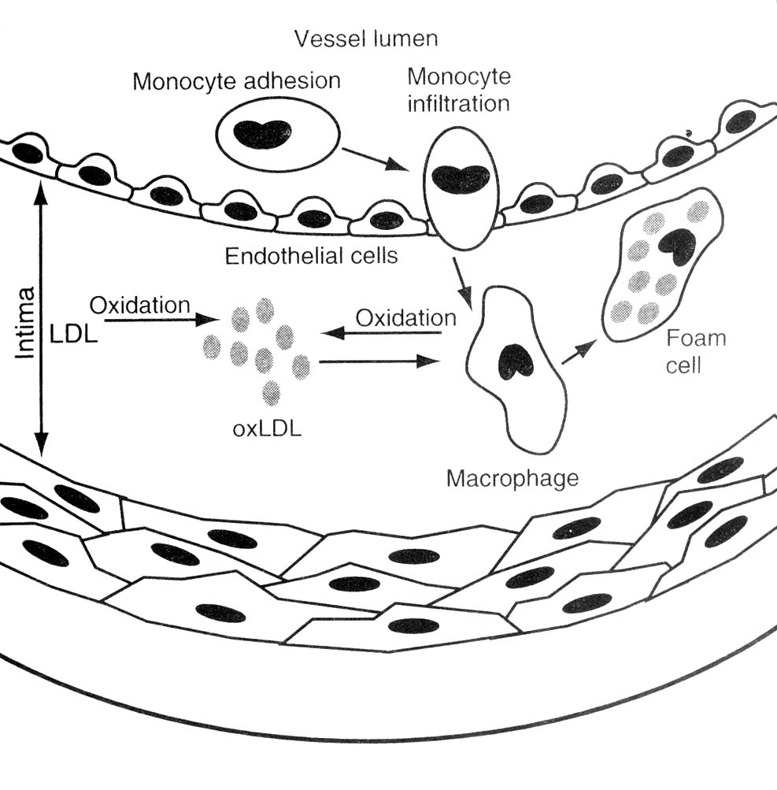
Pathogenesis
Fig : Foam cell formation-characterize the earliest atherosclerotic lesion

Slide 25
ATHEROSCLEROSIS IS AN INFLAMMATORY DISEASE
Monocyte
Adhesion
Molecule
MCP-1
Cytokines
GROWTH FACTORS
METALLOPTOTEINASES
Macrophage
Foam Cell
CELL PROLIFERATION
MATRIX DEGRADATION

Slide 26
LDL CAUSES ATHEROSCLEROSIS
Monocyte
LDL
Adhesion
Molecule
MCP-1
LDL
MODIFIED LDL
Cytokines
GROWTH FACTORS
METALLOPTOTEINASES
Macrophage
Foam Cell
CELL PROLIFERATION
MATRIX DEGRADATION

Slide 27
REMNANT LIPOPROTEINS CAUSE ATHEROSCLEROSIS
Monocyte
REMNANTS
Adhesion
Molecule
MCP-1
REMNANTS
MODIFIED
REMNANTS
Cytokines
GROWTH FACTORS
METALLOPTOTEINASES
Macrophage
Foam Cell
CELL PROLIFERATION
MATRIX DEGRADATION

Slide 28
HDL PROTECTS AGAINST ATHEROSCLEROSIS
Monocyte
LDL
Adhesion
Molecule
MCP-1
LDL
MODIFIED
LDL
Cytokines
GROWTH FACTORS
METALLOPTOTEINASES
Macrophage
CELL PROLIFERATION
MATRIX DEGRADATION

Slide 29
HDL PROTECTS AGAINST ATHEROSCLEROSIS
Monocyte
LDL
Adhesion
Molecule
MCP-1
LDL
MODIFIED
LDL
Cytokines
GROWTH FACTORS
METALLOPTOTEINASES
Macrophage
CELL PROLIFERATION
MATRIX DEGRADATION
HDL PROMOTE CHOLESTEROL EFFLUX

Slide 30
HDL PROTECTS AGAINST ATHEROSCLEROSIS
Monocyte
LDL
Adhesion
Molecule
MCP-1
LDL
HDL INHIBIT
OXIDATION OF LDL
MODIFIED
LDL
Cytokines
GROWTH FACTORS
METALLOPTOTEINASES
Macrophage
CELL PROLIFERATION
MATRIX DEGRADATION
HDL PROMOTE CHOLESTEROL EFFLUX

Slide 31
HDL PROTECTS AGAINST ATHEROSCLEROSIS
Monocyte
HDL INHIBIT ADHESION MOLECULE EXPRESSION
LDL
Adhesion
Molecule
MCP-1
LDL
HDL INHIBIT
OXIDATION OF LDL
MODIFIED
LDL
Cytokines
GROWTH FACTORS
METALLOPTOTEINASES
Macrophage
CELL PROLIFERATION
MATRIX DEGRADATION
HDL PROMOTE CHOLESTEROL EFFLUX

Slide 32
HDL PROTECTS AGAINST ATHEROSCLEROSIS
HDL INHIBIT ADHESION MOLECULE EXPRESSION
Monocyte
HDL INHIBIT MCP-1 EXPRESSION
LDL
Adhesion
Molecule
MCP-1
LDL
HDL INHIBIT
OXIDATION OF LDL
MODIFIED
LDL
Cytokines
GROWTH FACTORS
METALLOPTOTEINASES
Macrophage
CELL PROLIFERATION
MATRIX DEGRADATION
HDL PROMOTE CHOLESTEROL EFFLUX

Slide 33
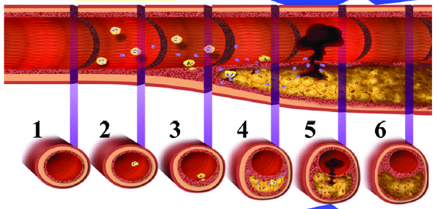
Pathogenesis
Fatty streak
Transitional plaque
Mature plaque
Ruptured plaque with
thrombus formation

Slide 34
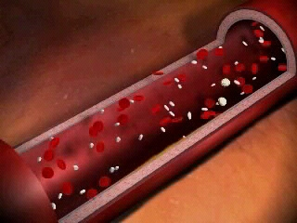
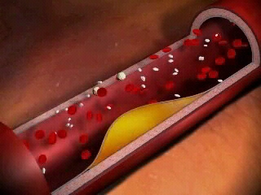
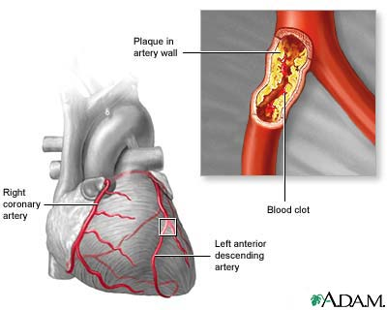
Pathogenesis
Normal vessel
Atherosclerotic plaque
Atheromas contain a core of lipid, largely
cholesterol, surrounded by a fibrous cap

Slide 35
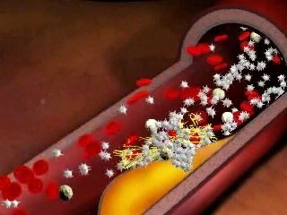
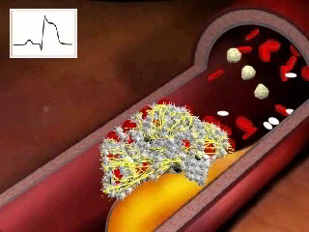
Pathogenesis
Plaque rupture
Vessel occlusion

Slide 36
Atherosclerosis Timeline
Foam
cells
Fatty
streak
Intermediate
lesion
Fibrous
plaque
Complicated
lesion/rupture
Atheroma
Endothelial dysfunction
From first
decade
From third
decade
From fourth
decade
Growth mainly by lipid accumulation
Smooth muscle
and collagen
Thrombosis,
haematoma
Pepine CJ. Am J Cardiol. 1998; 82 (suppl 104):23S-27S
Notes:
9
In fact, atherosclerosis begins in childhood after the first decade. Atherosclerosis is a progressive disease involving the development of arterial wall lesions. As they grow, these lesions may narrow or occlude the arterial lumen. Complex lesions may also become unstable and rupture, leading to acute coronary events, such as unstable angina, myocardial infarction, and stroke.
Pepine CJ. The effects of angiotensin-converting enzyme inhibition on endothelial dysfunction: potential role in myocardial ischemia. Am J Cardiol. 1998; 82(suppl 10A):244-275.

Slide 37
“Timeline” of Atherogenesis
1. Normal coronary artery
2. Lesion initiation and accumulation of extra cellular lipid
3. Evolution to the fibrof-atty stage
4. Lesion progression
5. Complicated plaque: disruption
6. Thrombus resorption, collagen
accumulation and SMC growth

Slide 38
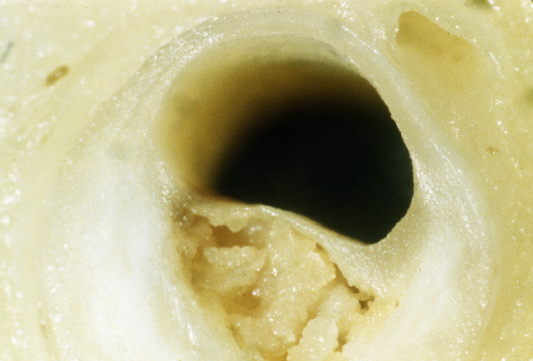
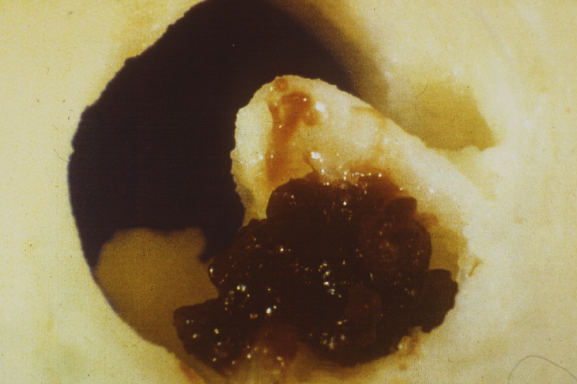

Slide 39
Rationale for Cholesterol Management
The “lipid hypothesis” - lowering serum cholesterol lowers risk of incidence of CHD events
Lowering s. chol by 10% reduces CHD risk by 20-30%
* Multiple Risk Factor Intervention Trial Research (MRFIT)

Slide 40
ATP III Recommendations
Third report of NCEP on Detection, Evaluation, and Treatment of High blood cholesterol in adults, (Adult treatment panel [ATP] III focus on comprehensive approach involving both therapeutic lifestyle changes (TLC) and, when appropriate drug treatment.

Slide 41
Approach to Cholesterol Management

Slide 42
History
Age
• Gender
Lifestyle
  Daily diet (saturated fat,cholesterol, carbohydrates, calories)
Tobacco use
Physical activity
  30-60 min/d or ≥ 3times/wk
  aerobic exercise (walking, cycling, jogging, etc)
Nature of occupation (e.g. sedentary)

Slide 43
History
CHD/Atherosclerosis (Patient/ Family)
  Ml
  Angina
  CABG
  PCI
  PAD
  AAA
  Carotid artery disease (symptomatic)
Family (premature) CHD
  < 55 yr in male relative
  < 65 yr in female relative
Diabetes/Hyperglycemia

Slide 44
Drug History
Antihypertensive medications
Medications causing secondary dyslipidemia
Other

Slide 45
Examination
Height / Weight
Waist circumference
  Abdominal obesity
  > 88 cm (> 35 in)female
  > 102 cm ( > 40 in) male
Hypertension
  ≥140/90 mm Hg
  ≥130/85 mm Hg (if metabolic syndrome)

Slide 46
Criteria for Accurate Lipid Profile
😐 Patient should fast for 14 hours
(water & fat free liquid allowed)
😐 Normal diet preceding two weeks
😐 Previous night meal should be fat free

Slide 47
Lab Test
Lipids
  Fasting lipoprotein profile
    TC
    LDL-C
    HDL-C
    TG
  Non-HDL-C (LDL-C + VLDL-C)
  in patients with TG ≥200 mg/dl

Slide 48
Lab Test
Fasting plasma glucose (FPG)
  111-125 mg/dL = impaired
  ≥ 126 mg/dL = diabetes
Clinical chemistry
  Hepatic function May indicate
  Renal function cause of
  Thyroid function 2ry dyslipidemia

Slide 49
Lab Test
Emerging risk factors
  Lipoprotein(a)
  Homocysteine
  Prothrombotic factors (eg fibrinogen conc.)
  Proinflammatory factors (eg CRP)
  impaired fasting plasma glucose

Slide 50
Differential Diagnosis
Primary dyslipidemia
The metabolic syndrome
Secondary dyslipidemia
  Underlying disorder
    Diabetes
    Hypothyroidism
    Obstructive liver disease
    Chronic renal failure
  Medication use
    Progestins/estrogens
    Anabolic steroids
    Corticosteroids
    Beta-blockers
    Retinoids
    Other

Slide 51
Patient Risk Assessment
Identify major risk factors
  Cigarette smoking
  Hypertension (≥ 140/90 mm Hg) or
  use of antihypertensive medication
  Low HDL-C (< 40 mg/dL)
  Family history of premature CHD
  (< 55 yr in first-degree male relative
  < 65 yr in first-degree female )
  Age (45 yr male; ≥ 55 yr female)

Slide 52
Patient Risk Assessment
Consider
  Life habit risk factors
  (obesity, phys. Inactivity, atherogenic diet)
  Emerging risk factors
  Risk factors for metabolic syndrome
  (secondary therapeutic goal)

Slide 53
Patient Risk Assessment
Assess 10-yr CHD risk in patients with ≥ 2 risk factors, but without
  CHD
  Other types of atherosclerotic disease
  Diabetes
  (Framingham Risk Scoring System)

Slide 54
Risk factors for Metabolic Syndrome
• Abdominal obesity
TG ≥ 150 mg/dL
HDL-C < 40 mg/dL (m), ≤ 50 mg/L (f)
BP ≥130/ ≥85 mm Hg
Fasting plasma glucose ≥110 mg/dL

Slide 55
Estimation of 10 Year Risk for Men
Framingham Point Scores
Age, Years | Points
20-34 | - 9
35-39 | - 4
40-44 | 0
45-49 | 3
50-54 | 6
55-59 | 8
60-64 | 10
65-69 | 11
70-74 | 12
75-79 | 13

Slide 56
Estimation of 10 Year Risk for Men
Framingham Point Scores
Total Cholesterol mg/dL | Points
 | Age 20-39 yrs | Age 40-49 yrs | Age 50-59 yrs | Age 60-69 yrs | Age 70-79 yrs
< 160 | 0 | 0 | 0 | 0 | 0
160-199 | 4 | 3 | 2 | 1 | 0
200-239 | 7 | 5 | 3 | 1 | 0
240-279 | 9 | 6 | 4 | 2 | 1
≥ 280 | 11 | 8 | 5 | 3 | 1

Slide 57
Estimation of 10 Year Risk for Men
Framingham Point Scores
Smoking | Points
 | Age 20-39 yrs | Age 40-49 yrs | Age 50-59 yrs | Age 60-69 yrs | Age 70-79 yrs
Non Smoker | 0 | 0 | 0 | 0 | 0
Smoker | 8 | 5 | 3 | 1 | 1
HDL mg/dL | Points
≥ 60 | -1
50-59 | 0
40-49 | 1
< 40 | 2
SBP mm Hg | Points
 | If untreated | If treated
< 120 | 0 | 0
120-129 | 0 | 1
130-139 | 1 | 2
140-149 | 1 | 2
≥ 160 | 2 | 3

Slide 58
Estimation of 10 Year Risk for Men
Framingham Point Scores
Point total | 10 year risk %
<0 | <1
0 | 1
1 | 1
2 | 1
3 | 1
4 | 1
5 | 2
6 | 2
7 | 3
8 | 4
Point total | 10 year risk %
9 | 5
10 | 6
11 | 8
12 | 10
13 | 12
14 | 16
15 | 20
16 | 25
≥17 | ≥30

Slide 59
FRAMINGHAM: CHD RISK
3
2
CHD RISK
1
25
45
65
HDL-C
(mg/dL)
0
85
100
160
220
LDL- cholesterol
(mg/dL)
* Men aged 50-70

Slide 60
NCEP Guidelines
Patients with
Diet therapy
indicated if
LDL-C
Drug therapy
indicated* if
LDL-C
LDL-C
treatment
goal
No CHD and <2 risk factors
No CHD and ≥2 risk factors
With CHD
≥160mg/dl
≥130mg/dl
>100mg/dl
≥190mg/dl
≥160mg/dl
≥130mg/dl
<160mg/dl
<130mg/dl
<100mg/dl
* Drug therapy indicated after 6 or more months of diet therapy (except patients with CHD) LDL-C <130mg/dl is desirable LDL-C ≥160mg/dl = high
(Adult Treatment Panel III, 2001)
Notes:
The National Cholesterol Education Program (NCEP) guidelines suggest that serum total cholesterol should be measured in all adults aged over 20 years at least once every 5 years. An initial classification involves determination of total and HDL cholesterol levels. For primary prevention in individuals free of CHD, total cholesterol levels of <200 mg/dl (5.2 mmol/l) are classified as ‘desirable blood cholesterol’; those of 200–239 mg/dl (5.2–6.0 mmol/l) as ‘borderline-high blood cholesterol’ and those of ≥240 mg/dl (6.2 mmol/l) as ‘high blood cholesterol’. At levels of cholesterol above the high blood cholesterol level the risk for CHD rises more steeply.¹ An HDL cholesterol level of lower than 35 mg/dl (0.9 mmol/l) is also associated with a higher CHD risk.
In those patients with 200–239 mg/dl (5.2–6.0 mmol/l) cholesterol, the level of HDL and the presence or absence of multiple other CHD risk factors determine the follow-up. If HDL cholesterol is <35 mg/dl (0.9 mmol/l) or there are two or more risk factors, then a lipoprotein analysis should be done. A lipoprotein analysis should also been performed in patients with a total cholesterol of ≥240 mg/dl (6.2 mmol/l).
Subsequent classification is based on LDL cholesterol; levels <130 mg/dl (3.4 mmol/l) are classified as ‘desirable LDL cholesterol’, those of 130–159 mg/dl (3.4–4.1 mmol/l) as ‘borderline-high risk LDL cholesterol’, and those of ≥160 mg/dl (4.1 mmol/l) as ‘high-risk LDL cholesterol’.
The recommended treatment for primary prevention in patients with less than two risk factors or more than two risk factors, and for secondary prevention, are shown.
Thus, in primary prevention the roles of drug therapy and dietary therapy are the same; to lower LDL cholesterol to <160 mg/dl (4.1 mmol/l) or to <130 mg/dl (3.4 mmol/l) if two other risk factors are present. For secondary prevention a reasonable goal of therapy is an LDL cholesterol of <100 mg/dl (2.6 mmol/l). Drug therapy is generally indicated for patients with established CHD or other atherosclerotic disease if LDL cholesterol levels are >130 mg/dl (3.4 mmol/l) after maximal dietary therapy.
Reference
1. National Cholesterol Education Program. Circulation 1994;98(3):1333–445.

Slide 61
ATP III Classification of Lipid (mg/dL)
Lipid level | Classification
LDL-C 100 100-129 130-159 160-189 >190 | Optimal Above optimal Borderline high High Very high
TC <200 200-239 >240 | Desirable Borderline high High
HDL-C <40 >60 | Low Desirable

Slide 62
Diagnosis & Management Algorithm (NCEP/ATP III)
1. Patient History and Complete Cardiovascular Examination
Age / Sex | Height / Weight / Waist circumference | Life style | Lipids | Hypertension
2. Diagnostic tests
BP | Lipids | Fasting Plasma Glucose | Clinical Chemistry – Liver, Kidney & Thyroid function
Hypertension | Dyslipidemia |  Plasma Glucose | Abnormalities
3. Differential Diagnosis
Underlying disorder
Primary Dyslipidemia | Metabolic Syndrome | Secondary Dyslipidemia
Medication use

Slide 63
Dietary Recommendations
☺ Fats <30% of Calories
(Saturated fat <7%)
☺ Carbohydrate 50%-60%
☺ Protein 15%
Diet
Phytosterol
Fish oil
Fiber 20-30 gm/day
Cholesterol <200mg/day

Slide 64
Fat in Cooking Oils
Oil Saturated Monounsat. Polyunsat.
Almond 9 73 18
Butter 65 30 4
Canola 7 62 31
Coconut 92 6 2
Corn 13 25 62
Cottonseed 27 19 54
Groundnut 18 48 34
Palm 51 39 10
Safflower 9 13 78
Sesame 15 42 43
Soya bean 15 24 61
Sunflower 11 20 69
Olive 14 77 9
Vege ghee 28 45 27

Slide 65
Cholesterol in Different Foods
Food Cholesterol
mg per 100 gm
Brain 2000
Egg, whole 550
Kidney 375
Liver 300
Butter 250
Lobster 200
Heart 150
Prawns 125
Cheese, Cheddar 100
Lard & animal fat 95
Milk, dried, whole 85
Cottage cheese 15
Mayonnaise, 1 tsp 10
Skimmed milk, 1 cup 5
Food Cholesterol
mg per 100 gm
Mango 9
Beef 70
Fish, steak 70
Fish, filet 70
Lamb 70
Pork 70
Cheese spread 65
Margarine
(2/3 animal fat
1/3 vegetable) 65
Mutton 65
Chicken 60
Ice-cream 45
Whole milk, 1 cup 34
Peas 9

Slide 66
Drugs used in Dyslipedemia
A. Bile Acid Sequestrates
Cholestyramine - 4-16 gm/day
Colestipol - 5-30 gm/day
Lowers LDL
B. Nicotinic Acid
Crystaline nicotinic acid - 1.5-3 gm/day
Inositol Nicotinate
Lowers Lipoprotein & Lipid metabolism

Slide 67
Drugs used in Dyslipedemia
C. Fibric Acid Derivatives
Clofibrate - 2 gm
Fenofibrate - 200 mg
Gemfibrozil - 1200 mg
Lowers TG, Raise HDL

Slide 68
Drugs used in Dyslipedemia
D. HMG Co-A Reductase Inhibitors
Atorvastatin - 10-80 mg
Fluvastatin - 20-80 mg
Lovastatin - 10-40 gm
Pravastatin - 10-40mg
Simvastatin - 5-80 mg
Rosuvastatin
Lowers LDL

Slide 69
Drugs used in Dyslipedemia
E. Ezetimibe
A new class of selective cholesterol absorption inhibitor

Slide 70
Mechanism of Action of Statins
Cholesterol Synthesis Pathway
acetyl CoA
HMG-CoA synthase
HMG-CoA
HMG-CoA reductase
X
Statins
mevalonic acid
mevalonate pyrophosphate
isopentenyl pyrophosphate
geranyl pyrophosphate
ubiquinones
farnesyl pyrophosphate
dolichols
Squalene synthase
squalene
cholesterol
Notes:
Statins, or HMG-CoA reductase inhibitors, are the most recently introduced class of lipid-lowering therapies and the most widely prescribed. The first commercially available statin, derived from the fungus Aspergillus terreus, was lovastatin.¹ Pravastatin, also fermentation-derived, was then developed and is structurally related to lovastatin.² Simvastatin, which is a chemically-modified lovastatin at a single position, has been used widely since 1991. The first synthetic or second generation statin was fluvastatin, available in the USA in 1994.
The body obtains cholesterol and triglyceride either by synthesising them in the liver or from the diet or storage sites in adipose tissue. The cholesterol synthesis pathway is a complex process involving many biochemical pathways and feedback mechanisms in the liver. Statins inhibit the HMG-CoA reductase, the enzyme involved in the rate-limiting step in the formation of cholesterol, which is usually responsible for two-thirds of the body’s cholesterol.³ In response to this the hepatocytes up-regulate and increase the number of LDL receptors, increasing binding and removal of LDL cholesterol and LDL precursors from the plasma. This results in an increase in HDL levels although the mechanism involved has not been fully established.⁴
References
1. Endo A. J Lipid Res 1992;33:1569–82.
2. Stein EA. Atherosclerosis 1994;108:S105–16.
3. Blumenthal RS. Am Heart J 2000;139:577-83.
4. Nawrocki JW et al. Atheroscler Thromb Vasc Biol 1995;15:678–82.

Slide 71
Pharmacokinetics of Statins
Statin
Metabolised
by CYP450
Protein
binding (%)
Lipophilic
Half-
life (h)
lovastatin
pravastatin
simvastatin
atorvastatin
cerivastatin
fluvastatin
Yes
No
Yes
Yes
Yes
Yes
>95%
~50%
95–8%
>98%
>99%
>98%
Yes
No
Yes
Yes
Yes
No
~2
~2
~3
~15
~3
~3
(Adapted from Horsmans 1999, Vaughan et al, 2000)
Notes:
Although all the statins are potent, reversible inhibitors of the enzyme HMG-CoA reductase, the key enzyme in cholesterol synthesis, there are major differences in the pharmacokinetic properties of the six available statins. These differences are due to differences in their chemical structures.^{1,2}
Reference
1. Horsmans Y. Eur Heart J Supplements 1999;1(Suppl T):T7–12.
2. Vaughan CJ et al. J Am Coll Cardiol 2000;35:1–10.

Slide 72
Effect of Lipid-lowering Therapies on Lipids
Therapy
Bile acid
sequestrants
Nicotinic acid
Fibrates
(gemfibrozil)
Probucol
Statins*
TC
Down
20%
Down
25%
Down
15%
Down
25%
Down
15–30%
LDL
Down
15–30%
Down
25%
Down
5–15%
Down
10–15%
Down
24–50%
HDL
Up
3–5%
Up
15–30%
Up
20%
Down
20–30%
Up
6–12%
TG
Neutral or up
Down
20–50%
Down
20–50%
Neutral
Down
10–29%
Patient
tolerability
Poor
Poor to
reasonable
Good
Reasonable
Good
TC–total cholesterol, LDL–low density lipoprotein, HDL–high density lipoprotein, TG–triglyceride. * Daily dose of 40mg of each drug (cerivastatin 0.3mg)
(Adapted from Yeshurun 1995, Knopp 1999)
Notes:
Lipid-lowering therapies include inhibitors of HMG CoA reductase (statins), fibrates, bile acid sequestrants (resins), nicotinic acid and its derivatives, and probucol. They have all shown varying degrees of efficacy in delaying the progression of atherosclerosis and some have also been shown to reduce MI and sudden death. A combination of two agents may be used to achieve greater efficacy in cases of severe hypercholesterolaemia. However, the most convincing evidence has been demonstrated with statins and, at present, they are first-line drugs in the treatment of dyslipidaemias.
Bile acid sequestrants are potent cholesterol-lowering agents. However, compliance can be a problem as patients may object to the taste and texture, and common adverse events are gastrointestinal bloating, nausea and constipation.^{1,2}
Nicotinic acid, a B-complex vitamin whose lipid-lowering properties were first described in the 1950s, is very effective at increasing HDL cholesterol levels and is indicated for all dyslipidaemias except congenital lipoprotein lipase deficiency. The value of nicotinic acid has been limited by the incidence of adverse events, which include flushing, skin problems, gastrointestinal distress, liver toxicity, hyperglycaemia and hyperuricaemia.^{1,2}
Fibrates are effective triglyceride-lowering drugs and, as such, are effective for patients with type III hyperlipoproteinaemia. In some patients they modestly lower LDL cholesterol and raise HDL cholesterol. However, in the majority of patients they are only moderately successful in reducing LDL cholesterol.^{1,2}
Probucol is prescribed for the treatment of high cholesterol levels. However, it has only a modest LDL cholesterol-lowering effect, and there is no evidence that it reduces CHD risk and there are limited long-term tolerability data.^{1,2}
Statins are highly effective in lowering LDL cholesterol and have a good tolerability profile.¹⁻³
References
1. Yeshurun D, Gotto AM. Southern Med J 1995;88(4):379–91.
2. National Cholesterol Education Program. Circulation 1994;98(3):1333–445.
3. Knopp RH. N Engl J Med 1999;341:498–511.

Slide 73
Lipid-Modifying Effects of Drugs
 | LDL-C | HDL-C | TG
Bile acid sequestrants | ↓15%-30% | ↑5% | ↔
HMG-CoA red. Inh. | ↓20%-60% | ↑5%-15% | ↓10%-40%
Fibric acid derivatives | ↔ ↓10%-15% | ↑5%-20% | ↓20%-50% derivatives
Nicotinic acid | ↓20%-30% | ↑15%-35% | ↓20%-50%

Slide 74
Effect of Atorvastatin (10/d) vs Placebo on
Primary & Secondary outcome
Event type | Placebo % | Atorvastatin %
Primary end points (cardiovascular events) | 9.0 | 5.8
Acute coronary events | 5.5 | 3.6
Coronary revascularization | 2.4 | 1.7
Stroke | 2.8 | 1.5
Secondary end points
Death from any cause | 5.8 | 4.3
Any acute cardiovascular events | 13.4 | 9.4
Annals of In Med. Aug,2005; 143 (3):212-213

Slide 75
AVERT: Angina Status

Slide 76
Benefits of ‘Statins’ (as per results of various prospective randomised trials)
Arrests as well as prevents the process of atherosclerosis
Reduces total and cardiovascular mortality
Reduces CHD events such as nonfatal myocardial infarction, angina
Reduces incidence of heart failure
Reduces the risk of cerebrovascular events such as stroke
Reduces need for revascularisation procedures such as angioplasty / bypass surgery
Reduces number of hospitalisations/duration of hospital stay
Ann Pharmacother 1998; 32: 1030–1043
Atheroscler 1999; 143 (suppl 1): S17–S21

Slide 77
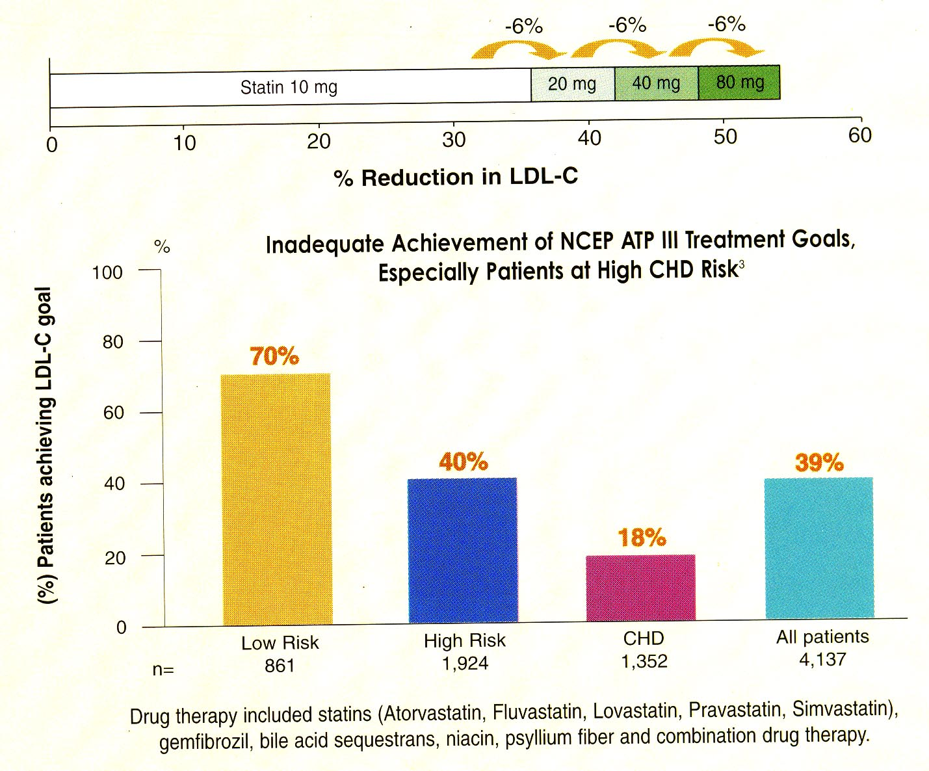
Limitations of 'Statins'
 Only 18% pts with CHD achieve recommended LDL-C goal of <100 mg/dL with statin alone.
 ATP III acknowledge the “Rule of 6” limitation of statins:
For every doubling of the statin dose, LDL-C is lowered only by another 6% and majority of the LDL-C lowering occurs at the lowest statin dose.
1. ATP III, JAMA 2001; 285:2486-2497
2. Grundy SM et al. J Am Coll Cardiol 2004;43:2142-2146

Slide 78
Limitations of 'Statins'
1. ATP III, JAMA 2001; 285:2486-2497
2. Pearson TA ea al. Arch Intern Med 2000;160:459-467

Slide 79
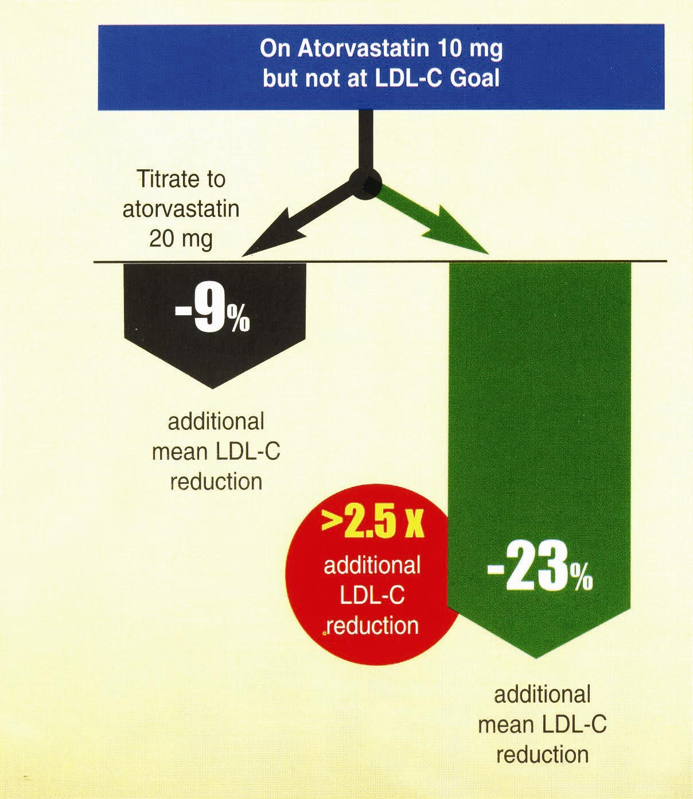
'Ezetimibe' and 'Statins'
Helps to meet the challenge in aggressive LDL-C reduction
Add
Ezatimibe
Stein E, Stenderd S, Mata P, et al. Am Heart J. 2004; 148:447-455

Slide 80
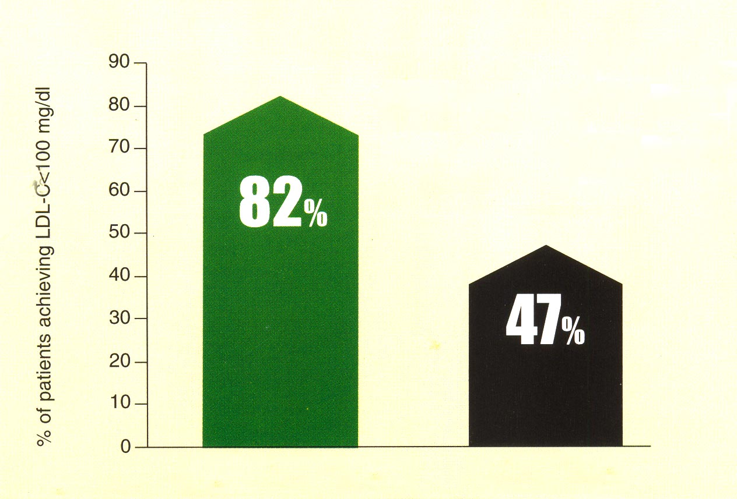
'Ezetimibe' and 'Statins'
Ensure achieving LDL-C goal (<100 mg/dL)
in combination with atorvastatin
Am Heart J. 2005; 149:464-473

Slide 81
Relationship Between Changes in
LDL-C and HDL-C Levels and CHD Risk
1% decrease
in LDL-C reduces CHD risk by 1%
1% increase
in HDL-C reduces CHD risk by 1%
Notes:
In the USA, the NCEP Expert Panel have estimated, based on data from epidemiology studies as well as intervention studies, that each 1% decrease in LDL-C equates to a 1% reduction in CHD risk.
In addition, every 1% increase in HDL-C equates to a 3% reduction in CHD risk.
Reference
1. Third Report of the NCEP Expert Panel. NIH Publication No. 01-3670 2001. http://hin.nhlbi.nih.gov/ncep_slds/menu.htm

Slide 82
Drug Selection Based on Lipid Fractions
 | Single Drug | Combination Drug
Elevated LDL-C and TG <200 mg/dL | Resin Statin Nicotinic acid | Resin + statin Statin + nicotinic a. Resin + nicotinic a.
Elevated LDL-C and TG 200 - 499 mg/dL | Nicotinic acid Statin Fibrate | Nicotinic a.+ statin Stalin + fibrate Nicotinic a.+ resin Nicotinic a.+ fibrate

Slide 83
Key points of ATP III
ATP III most notably-
  Advocate more intensive risk reduction therapy by assigning patients to 1 of 3 CHD risk categories (high, intermediate and low) rather than emphasizing the categories of primary and secondary prevention .
  Use the Framingham Risk Scoring system to calculate 10 years risk
  Designate certain disorders as CHD risk equivalents in the highest risk category, even if they do not have established CHD.

Slide 84
Key points of ATP III
Consider the importance of specific non lipid factors. (e.g. Inflammation). Which are included in a group of emerging risk factors.
Recognize that elevated Triglyceride (TG) levels and low levels of HDL-C are independent predictors of CHD.
Emphasize physical activity in addition to dietary modification (TCL)

Slide 85
Key points of ATP III
Identify the metabolic syndromes, which increases a patients risk for CHD at any LDL-C level.
Risk factors for the metabolic syndrome:
  abdominal obesity
  hypertension
  elevated TG
  low levels of HDL-C and
  impaired glucose tolerance

Slide 86
Key points of ATP III
Because atherosclerosis formation represents an advanced stage of cardiovascular disease, it is essential to treat patients before lesions develop.
By identifying multiple risk factors beyond elevated LDL-C levels physician will be better able to recognize and treat CHD before it progresses to atherosclerosis formation.

Slide 87
Take Home Massage
 ATP III for the NCEP has introduced new guidelines for the management of high cholesterol by including an update risk definition. The panel now advocates a serum LDL level <100 mg/dL for persons with DM and higher CVS risk.
 In type 2 diabetic patients with at least 1 additional risk factor for coronary heart disease (CHD), lipid-lowering treatment with statins is effective for primary prevention of cardio vascular disease.
Annals of In Med. Aug,2005; 143 (3):212-213

Slide 88
Take Home Massage
 In patients with acute coronary syndromes (ACS), early initiation of intensive lipid-lowering treatment to achieve serum LDL-C levels below 1.80 mmol/L (<70 mg/dL) prevents major cardiovascular events more effectively than moderate lipid-lowering.
Annals of In Med. Aug,2005; 143 (3):212-213

Slide 89
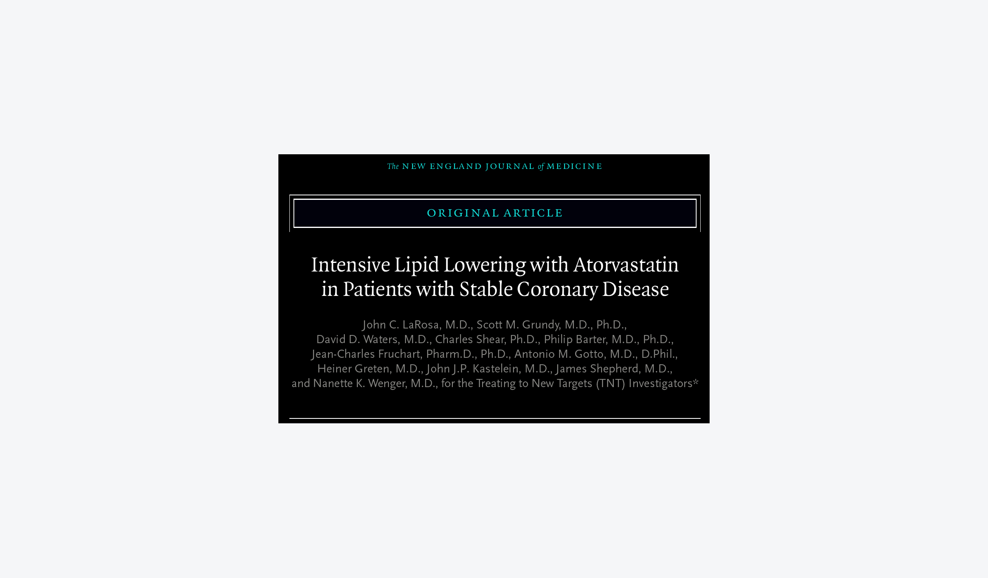
Take Home Massage

Slide 90
Take Home Massage
 Statin treatment could be benefit a greater number of pts and that target LDL-C levels for treatment of pts at highest risk should be lower than previously recommended. Because treatment with statins for as long as 10 yrs appears to be safe.
 An intensive lipid-lowering statin regimen provided greater protection against major cardiovascular events than a standard regimen for patients who had recently had an ACS.
Annals of In Med. Aug,2005; 143 (3):212-213

Slide 91


